Slide 1
Cricket score prediction
S.Shiyam saran(122012012830)
J.Vishnu(122012012894)
M.Mahizhan(122012012862)

Slide 2
Project abstract
This project aims to develop a deep learning model to predict cricket match scores based on historical match data.
The primary motivation is to improve predictive accuracy in sports analytics, aiding commentators, teams.

Slide 3
Methodology
1. Data Collection: Using an IPL dataset containing match details such as venue, teams, players, and past scores.
2. Data Preprocessing:
Removing irrelevant features.
Encoding categorical variables using Label Encoding.
Normalizing data using MinMax scaling

Slide 4
Methodology
Model Development:
Using a sequential model with fully connected dense layers.
Implementing a deep learning model using Keras
Optimizing the model with Huber loss and Adam optimizer.

Slide 5
Methodology
Training and Evaluation:
Splitting the data into training and testing sets.
Training the model for 50 epochs with batch size 64.
Evaluating using Mean Absolute Error (MAE) and Mean Squared Error (MSE).

Slide 6
interactive Prediction Tool:
Implementing an interactive widget using IPython widgets.
Allowing users to input match conditions and obtain score predictions.

Slide 7
Libraries required
import pandas as pd
import numpy as np
import matplotlib.pyplot as plt
import seaborn as sns
from sklearn import preprocessing
import keras
import tensorflow as tf

Slide 8
ipl = pd.read_csv("ipl_data.csv")
ipl.head()
df = ipl.drop(['date', 'runs', 'wickets', 'overs', 'runs_last_5', 'wickets_last_5','mid', 'striker', 'non-striker'], axis =1)
X = df.drop(['total'], axis =1)
y = df['total']

Slide 9
from sklearn.preprocessing import LabelEncoder
venue_encoder = LabelEncoder()
batting_team_encoder = LabelEncoder()
bowling_team_encoder = LabelEncoder()
striker_encoder = LabelEncoder()
bowler_encoder = LabelEncoder()

Slide 10
X['venue'] = venue_encoder.fit_transform(X['venue'])
X['bat_team'] = batting_team_encoder.fit_transform(X['bat_team'])
X['bowl_team'] = bowling_team_encoder.fit_transform(X['bowl_team'])
X['batsman'] = striker_encoder.fit_transform(X['batsman'])
X['bowler'] = bowler_encoder.fit_transform(X['bowler'])

Slide 11
from sklearn.model_selection import train_test_split
X_train, X_test, y_train, y_test = train_test_split(X, y, test_size=0.3, random_state=42)
from sklearn.preprocessing import MinMaxScaler
scaler = MinMaxScaler()
# Fit the scaler on the training data and transform both training and testing data
X_train_scaled = scaler.fit_transform(X_train)
X_test_scaled = scaler.transform(X_test)

Slide 12
model = keras.Sequential([
keras.layers.Input( shape=(X_train_scaled.shape[1],)), # Input layer
keras.layers.Dense(512, activation='relu'), # Hidden layer with 512 units and ReLU activation
keras.layers.Dense(216, activation='relu'), # Hidden layer with 216 units and ReLU activation
keras.layers.Dense(1, activation='linear') # Output layer with linear activation for regression
])
# Compile the model with Huber loss
huber_loss = tf.keras.losses.Huber(delta=1.0) # You can adjust the 'delta' parameter as needed
model.compile(optimizer='adam', loss=huber_loss) # Use Huber loss for regression

Slide 13
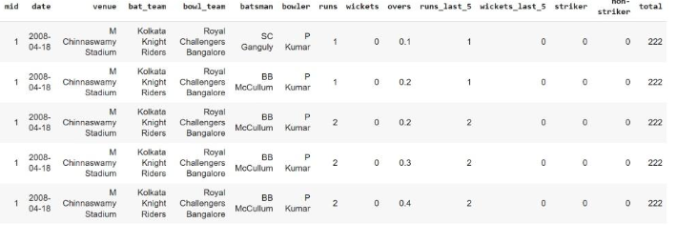
Dataset overview

Slide 14
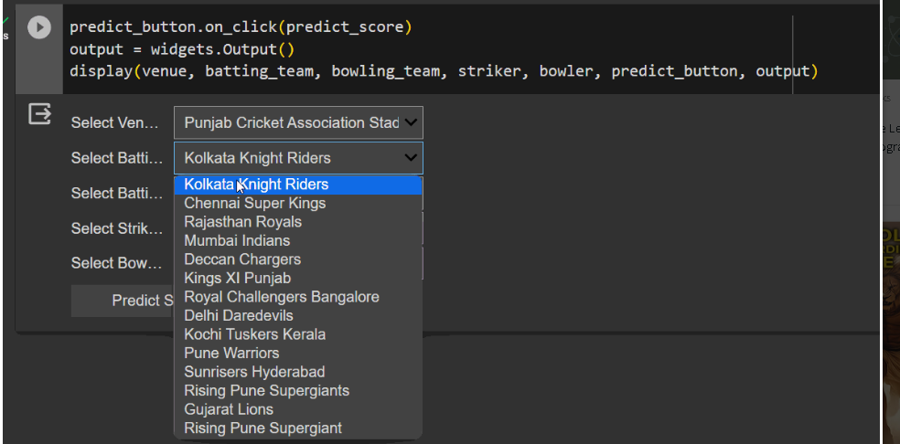

Widget and output overview

